Slide 1
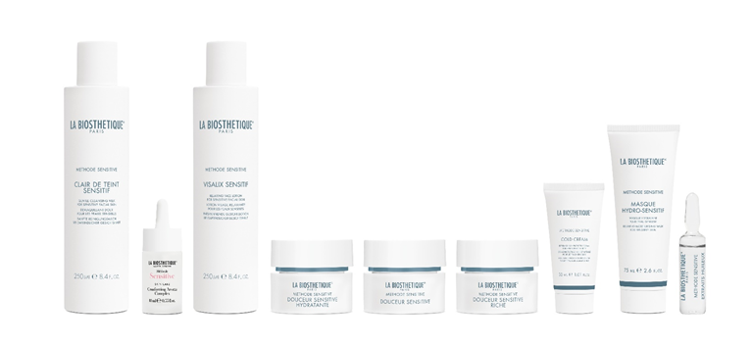
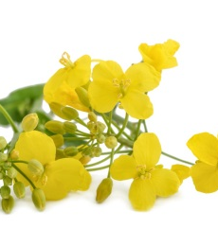
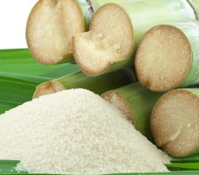
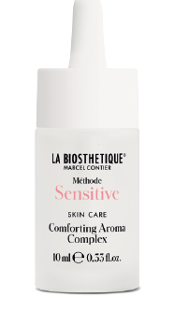
Méthode Sensitive - for sensitive skin
OAT LIPIDS/PHYTOSTEROLS/SQUALANE
Relieves itching
Soothes burning and flaking
Comforting Aroma Complex - ready-to-use aroma oil
Comforting Aroma Concentrate - use only diluted
Antistress - care oil for all irritated skin conditions
Soothes irritated skin. Relaxed, astringent, balanced complexion
Effect through inhalation: Mood-enhancing, stress-relieving
mandarin oil, bergamot fruit oil, bitter orange blossom oil, bitter orange leaf oil
Clair de Teint Sensitif
The first step towards beautiful skin!
Very mild cleansing,
without drying the skin.
Vegetable surfactants
Visalix Sensitif
Preparation of the skin for the care cream.
Apply soothing facial lotion in the morning and evening.
Natural moisturising factors
Notes:
Apple pectin/malic acid/algae extract/lupin extract

Slide 2
Méthode Sensitive - for sensitive skin
Douceur Sensitive Hydratante
Relaxing moisturising care
Douceur Sensitive
Fast-absorbing cream for day and night for normal to slightly dry skin.
Douceur Sensitive Riche
Rich cream for day and night for very dry skin. Special massage cream
Skin-related squalane for a silky skin feel without greasiness.
Cold Cream
Protective cover for the skin against red veins, children's skin
Almond oil, arginine, beeswax
Masque Hydro-Sensitif
SOS mask for every skin type
Intensive moisturiser with skin repair active ingredients
Marine saccharides from plankton, blackcurrant seed oil, balloon vine extract, sunflower oil concentrate
Extraits Huileux
Oil extract ampoule for very sensitive skin. Mix 1:1 with Masque Peeling for special massage and skin polishing.
Vitamin F from safflower oil, vitamin E
Notes:
Apple pectin/malic acid/algae extract/lupin extract

Slide 3
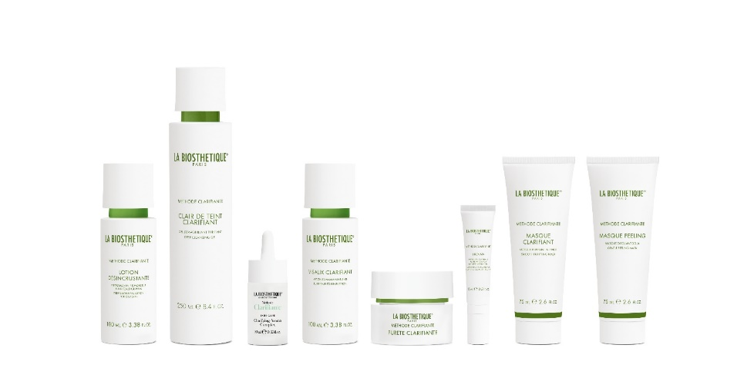
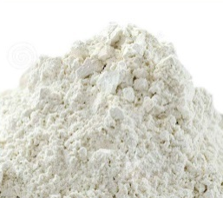
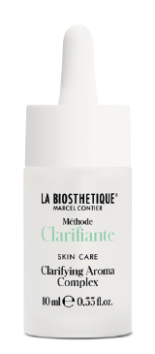
Méthode Clarifiante - for blemished skin
GARCINIA MANGOSTANA/
LICORICE ROOT/KAOLIN
For a clearer complexion without drying it out
Quickly soothes Inflammation, fresher, clearer skin feeling
Clarifying Aroma Complex - ready-to-use aroma oil
Clarifying Aroma Concentrate - use diluted only
Clarifying for clear facial skin
Antibacterial, purifies oily skin, renews the skin, leaves no greasy shine
Effect through inhalation: has a stress-relieving, mood-enhancing effect
Damask rose, lemon peel oil, orange peel oil, bergamot, Roman chamomile blossom oil
Lotion Desincrustante
Apply anti-shine liquid peeling before cleansing.
Flash peeling before make-up.
Clair de Teint Clarifiant
Refreshing cleansing gel with sebum-reducing properties without drying out the skin
Visalix Clarifiant
Anti-blackhead lotion. Improves the removal of sebum, soothes. Use twice daily after cleansing.
Notes:
Apple pectin/malic acid/algae extract/lupin extract

Slide 4
Méthode Clarifiante - for blemished skin
Creme Purete Clarifiante
Highly effective base cream for clear skin. Has an anti-inflammatory, soothing and moisturising effect.
Garcinia magnostana, malachite extract, active complex of rice, rosemary and sugar beet, NMF complex for moisture
Likopan gel
Power gel against spots. Anti-inflammatory, soothes the skin. Apply to spots several times a day.
Garcinia magnostana, malachite extract, active complex of rice, rosemary and sugar beet, NMF complex for moisture
Masque Peeling
Gentle, skin-refining mask.
5- 10 min EWZ.
or mix 1:1 with Clair de Teint as a crash peeling.
Fine, round-ground silica gel
Masque Clarifiant
Skin clarifying mask, absorbs excess sebum. Use overnight as a cream to treat heat rash on the décolleté and back.
Bisabolol, kaolin, vitamin A + E
Notes:
Apple pectin/malic acid/algae extract/lupin extract

Slide 5
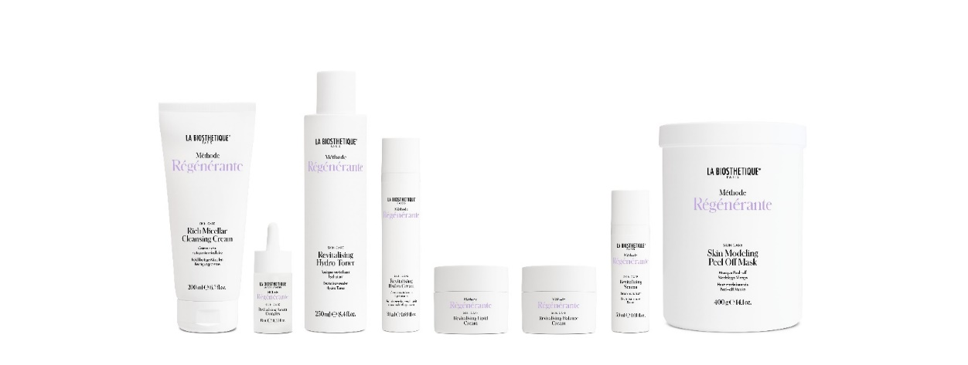
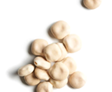
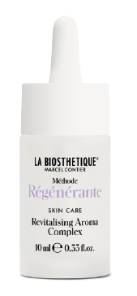
Méthode Régénérante - Well- Aging Care
encapsulated edelweiss extract/vegetable lipoamino acids/
GREEN MICROALGAE
Well-ageing formula actively combats skin ageing before it becomes visible.
Reduced Inflamm-aging, suitable from 25 years to 75+.
Encapsulated active ingredients have a targeted effect on collagen production and connective tissue.
Revitalising Aroma Complex - ready-to-use aroma oil
10 ml retail size
Revitalising Aroma Concentrate - use diluted only
30 ml cabinet size
Vitalising for a fresh complexion, tightens the tissue, invigorating, very refreshing, stimulates circulation.
Effect through inhalation: energises, promotes regeneration.
Thyme, rosemary, mint, rose geranium, peppermint
Rich Micellar Cleansing Cream
Cleanses face and eye make-up quickly and gently.
Leaves the skin feeling relaxed and nourished.
Glycolipids obtained from 100 % natural sugar building blocks form micelles that attract dirt like magnets.
Revitalising Hydro Toner
Intensively refreshes and revitalises the skin with moisture.
Microalgae, white lupins,
Skin-identical moisturising building blocks
Notes:
Apple pectin/malic acid/algae extract/lupin extract

Slide 6
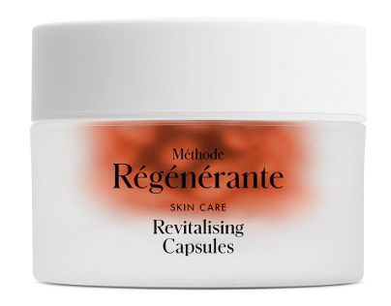
Méthode Régénérante Well-Aging Care
Revitalising Serum
For face, neck and eye contours (replaces eye cream)
Refines any skin texture. Ideal for long-term use.
Very well tolerated even by sensitive skin.
Apply daily to toned skin.
Phyto-retinol from baccuchiol, pistacia resin
Révitalising Capsules
The facial care oil made from borage, beta-carotene and seaweed extract revitalises and protects at cellular level. The intensively nourished skin is finer-pored, firmer and silky smooth.
Gamma-linolenic acid from borage oil, macadamia nut oil, freshwater algae, winged kelp
Révitalising Hydro-Cream
Moisturising cream for every skin condition
Feather-light texture, skin is soothingly nourished
Rambutan (Asian superfruit, similar to lychee) optimises moisture levels
Révitalising Balance Cream
For skin conditions from slightly dry to combination skin. Well absorbed.
Active ingredient from TCM fungi protects the epidermis from stress caused by environmental factors.
Révitalising Lipid Cream
Nourishes very dry skin
Vitamin F from polyunsaturated fatty acids, which the body cannot produce itself.
Notes:
Apple pectin/malic acid/algae extract/lupin extract

Slide 7
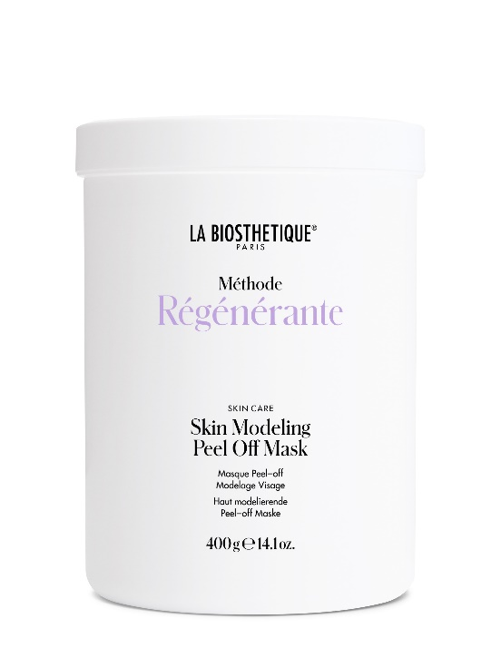
Méthode Régénérante Well-Aging Care
Skin Modelling Peel Off Mask
For face and body
For professional use only
Multifunctional modelling.
10 - 20 minutes application time.
The skin is remodelled and strengthened.
Application: see Home of Education
Notes:
Apple pectin/malic acid/algae extract/lupin extract

Slide 8
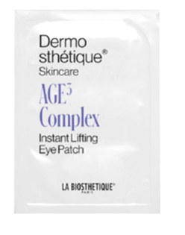
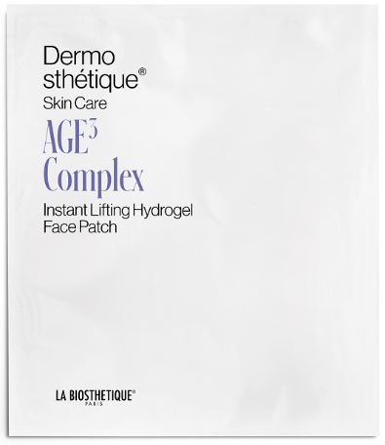
Dermosthétique ® AGE ³ REVERSAL TECHNOLOGY
Past, present, future:
Rejuvenation through anti-glycation
Vitalising through skin cell activation
Protected with DNA cell protection
INSTANT LIFTING
FACE PATCH
Hydrogel face pad with instant lifting effect
20 min development time
Fragrance-free
Age ³ complex, glucomannan
Ectoin
INSTANT LIFTING
EYE PATCH
Hydrogel eye pads with
Instant lifting effect.
Fragrance-free
Age ³ complex, glucomannan
LIFTING EYE CREAM
Skin-firming eye care
Against dark eye circles and puffy eyes
Green tea, pomegranate, caffeine, fermented probiotic oat extract, squalane
REDEFINING LIP BALM
Lip balm for smoother, more voluminous lips
Reduces fine lines
Plankton extract, encapsulated hyaluronic acid, shea butter, castor oil, jojoba ester
AGE REVERSING NIGHT CREAM
Rich regeneration care for the night to look a little younger every morning.
Soothes skin irritations by strengthening the microbiome.
Age ³ complex, ceramides, phytosterols, oat extract
AGE REVERSING DAY CREAM
Well-absorbed day cream to look a little younger every day.
Apply to cleansed, toned skin.
Age ³ complex, tiger grass, rosemary, algae
Notes:
Apple pectin/malic acid/algae extract/lupin extract

Slide 9
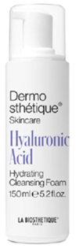
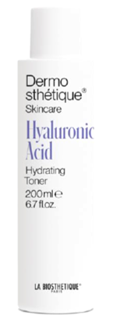
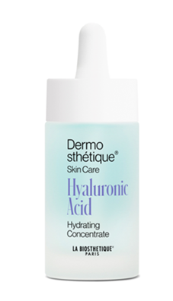
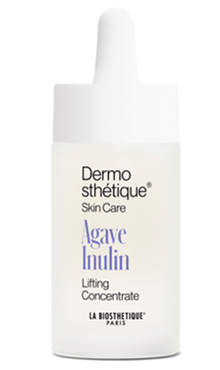
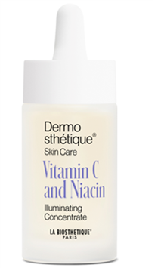
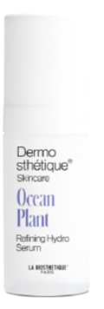
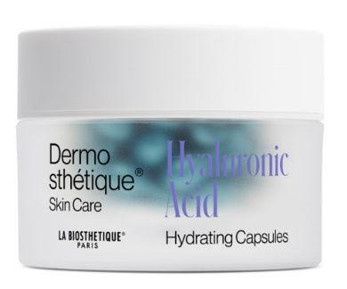
Dermosthétique ® HYALURON CONCEPT
HYDRATING CLEANSING FOAM
The cleansing mousse cleanses without drying out the skin
Perfume free.
Oat protein, sugar beet, hyaluronic acid,
Fragrance-free
HYDRATING TONER
The hydrolotion prepares the skin for a perfect absorption of active ingredients of the moisturiser. Moisturises and energises the skin.
Hyaluronic acid, Centella Asiatica
HYDRATING CONCENTRATE
Moisturising booster
Plumps the skin from the inside.
Tightens the skin. Fragrance-free
4 different hyaluronic acids + red seaweed, copper gluconate
LIFTING CONCENTRATE
Skin-firming lifting concentrate.
Against all types of wrinkles
Fragrance-free
Paracress relaxes mimic lines
Agave wrinkle filler
ILLUMINATING CONCENTRATE
Against pigmentation disorders. For more even skin tone. Fragrance-free
Vitamin C reduces melanin synthesis
Niacinamide has a brightening effect and reduces excessive pigmentation
HYDRATING CAPSULES
Hydro lipogel against an unstable barrier layer. Increases ceramide synthesis, instantly smoother skin
Short-chain hyaluronic acid, konjac mannan, salicornia extract, marine sea fennel
REFINING HYDRO SERUM
Skin-refining hydro serum for dehydrated skin with enlarged-pores.
Energy boost for the skin.
Also suitable on its own or in combination with the concentrates.
Taurine stimulates the skin's microcirculation,
a postbiotic active ingredient from plankton reduces skin impurities
Notes:
Apple pectin/malic acid/algae extract/lupin extract

Slide 10
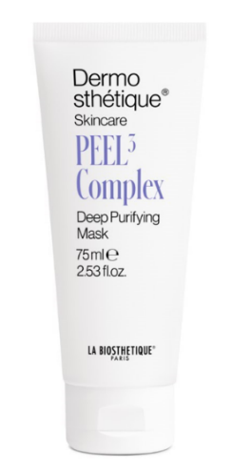
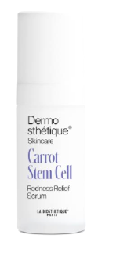
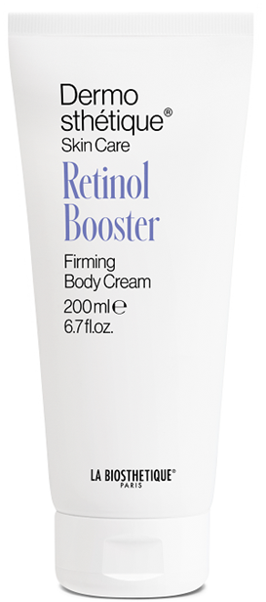
Dermosthétique ® SPECIAL PRODUCTS
PEEL³ DEEP PURIFYING MASK
Skin-refining cream scrub for all skin types
1-2x week/ avoid eyes.
Max 20 min development time.
Can also be used as an express peeling without application time.
shells of fossilised diatoms, enzymes from pomegranate, encapsulated Fruit acids
REDNESS RELIEF SERUM
Serum against skin redness with anti-pollution protection
Apply twice daily to the affected areas of skin.
Basic care tailored to the skin situation and season.
Also suitable on its own.
Extracts from carrot stem cells (reduces redness)
2 algae species (Corallina Officinalis, Palmaria Palmata)
improved microcirculation of the blood capillaries
Oat extract strengthens the microbiome,
Schizophyllan as an anti-pollution shield
FIRMING BODY CREAM
Intensive body care with skin-friendly anti-ageing effect for a firm skin structure.
Builds up a depot of the body's own retinol, which gradually makes the skin appear firmer and refined. Also ideal for body skin prone to impurities. Apply daily to cleansed skin.
Encapsulated resin made from Pistacia Resin.
Moisturising urea
Fresh, slightly floral fragrance
Without allergenic ingredients
Notes:
Apple pectin/malic acid/algae extract/lupin extract

Slide 11
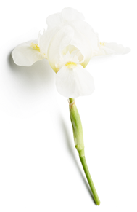
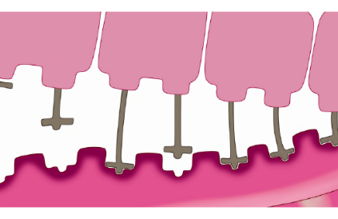
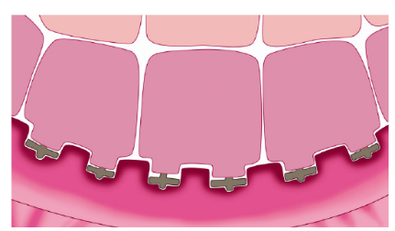
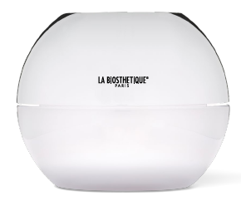
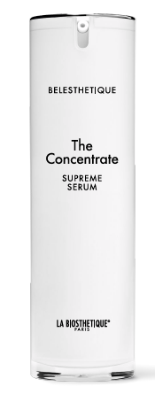
Belesthétique - timeless beauty for the skin
IRIS FLORENTINA
Strengthens the connection of the dermis and epidermis.
Rejuvenated facial contour
Youthful radiance
Reduces the loss of skin contours
WHITE TRUFFLE
Wrinkle filler
Anti-wrinkle effect
Reduction of mimic lines
The Cream
Supreme Lifting Cream for day and night
Visibly firmer skin
Intensive anti-wrinkle effect
Reduction of mimic lines
High-quality cell protection
93 % of the ingredients are of natural origin
Iris Florentina, white truffle, paracress, lupin seed extract, cell protection complex
The Eye Cream
Lifting eye and lip care
Relaxation of mimic lines and pleated wrinkles
Firming of the skin layers
Tightening
Reduction of dark shadows under the eyes
hawkweed extract, paracress, Iris Florentina, white truffle, lupin seed extract
The Concentrate
Use Supreme Detox Serum alone or under the cream
Triple detox effect of the skin cells
Activation of the skin's own lipid synthesis
72 hours moisturising effect
Olive leaf extract, jujube extract, rockrose, Iris Florentina, white truffle
Notes:
Apple pectin/malic acid/algae extract/lupin extract

Slide 12
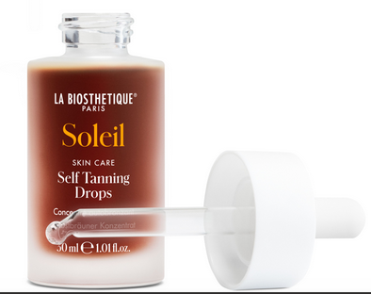
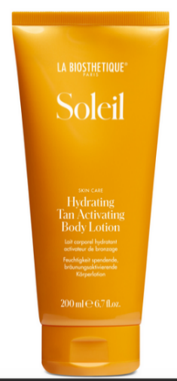
Soleil - before the sun
TANNING ACTIVATOR, ROSEMARY EXTRACT, SUNFLOWER EXTRACT
For a healthy tan with D N A cell protection
Modern UVA and UVB broadband filter, water-resistant SPF
Biomimetic emulsion
With an exclusively sensual, fresh fragrance composition
SELF TANNING DROPS
Fast, even tanning without the sun
Apply 2-5 drops once a day in the morning or evening to the face, neck and décolleté. Leave briefly to absorb.
DHA- Natural active ingredient that reacts with the scale layer, hydrocomplex, no UV filter included.
Before the sun: HYDRATING TAN ACTIVATING BODYLOTION
Stimulates the natural tanning process.
Initial treatment: a few days before sun exposure. Continuous use: Apply to cleansed skin once a day in the morning or evening.
Tanning activator, vitamin E acetate, moisture stabiliser (sorbitol)
Notes:
Apple pectin/malic acid/algae extract/lupin extract

Slide 13
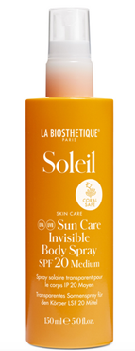
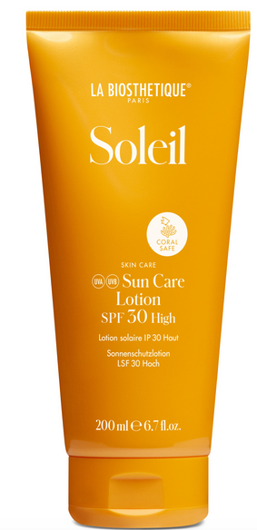
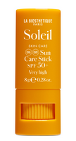
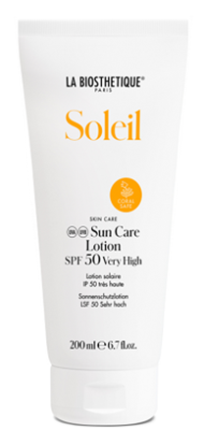
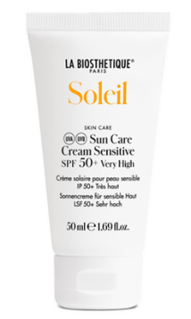
Soleil - Sun protection
SUN CARE INVISIBLE BODY SPRAY SPF 20
Waterproof, transparent sun spray with tanning activator
Not for the face.
Tanning activator, cell protection from sunflower seeds, natural antioxidants, modern UVA and UVB light protection filter system, contains alcohol.
SUN CARE LOTION SPF 30
Face and body
Leaves no visible greasy film on the skin. Extremely skin friendly confirmed in dermatological tests.
DNA cell protection, modern UVA and UVB light protection filter system
SUNCARE STICK SPF 50+
Waterproof cream stick for particularly sensitive skin areas such as lips,nose, ears, forehead, scalp, shoulders
Jojoba oil,waxes from berry, vitamin E, modern UVA and UVB protection filter system
SUN CARE CREAM SENSITIVE 50+
Perfume-free sun cream for daily use
SUN CARE LOTION SPF 50
Perfume-free sun protection lotion
Delicately melting, biomimetic sun care. Absorbs quickly.
Very high sun protection for dry, sensitive skin without "whitening", without a greasy shine or stickiness.
Double protection against light-induced skin ageing.
Intelligent DNA cell protection, rosemary extract, sunflower seeds, modern UVA and UVB light protection filter system, plant-based moisturisers
Notes:
Apple pectin/malic acid/algae extract/lupin extract

Slide 14
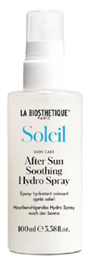
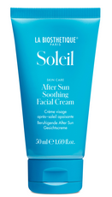
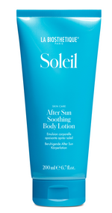
Soleil - after the sun
AFTER SUN SOOTHING HYDRO SPRAY
Soothing hydro spray for face and body
Soothes and moisturises the skin after sun exposure
For a refreshing boost throughout the day. Simply spray onto face and body. Can be used several times a day.
Aloe vera, panthenol, natural NMF factors, plant saccharides act like a moisturising magnet and bind moisture in the upper layers of the skin
AFTER SUN SOOTHING FACIAL CEAM
Soothing face cream
Supports the skin's own repair mechanism.
Reduces redness, burning skin sensation. Moisturises the skin.
Regeneration through phytosterols from rapeseed + squalane, intelligent DNA cell protection, rosemary extract, antioxidants, vitamin E acetate
AFTER SUN SOOTHING BODY LOTION
After Sun Emulsion
Cooling body milk.
Reduces redness and a burning sensation on the skin.
Extremely skin friendly.
Intelligent DNA cell protection, rosemary extract, antioxidants,
Moisturising complex of aloe vera, sorbitol and others
Notes:
Apple pectin/malic acid/algae extract/lupin extract

Slide 15
Spa body care - wellness and health
SPA body care combines wellness and health in a unique way. Protected and balanced skin flora thanks to prebiotic active ingredients.
Refreshing Hand Wash
Micellar cleansing gel for hands
Complex of brown algae, green microalgae, marine polysaccharides
Relaxing Wellness Soap For gentle cleansing of face and body Shea butter, vegetable glycerine
Relaxing Body Wash
Keeps body skin healthy, even when showering frequently.
Prebiotics and glucan oligosaccharides keep the skin flora in balance.
Refreshing Body Peeling
Natural bamboo exfoliating grains
Prebiotic active ingredient from plant insulin balances the skin flora.
Relaxing Bath Essence
Maltodextrin has a humectant effect to retain moisture in the skin. Relaxing fragrance essences and aromas Maltodextrin. Mild surfactants
Relaxing Body Lotion
Components of the skin's own NMF moisturise the skin.
Prebiotics and glucan oligosaccharides keep the skin flora in balance
Wellness Hair Shampoo
The unisex fragrance makes shampooing a sensual feel-good experience
Pure plant-based prebiotics such as inulin and glucan oligosaccharides keep the scalp flora in balance
Wellness Hair Conditioner
Cationic care substances prevent electrostatic charging and the "flying" of the hair.
After 2 minutes development time, rinse with water
Learning poster SPA 06.2023

Slide 16
Spa body care - wellness and health
The skin relaxes noticeably and improves from the very first
Applications. Coordinated active principle with wellness fragrance.
Intensive Hand Care Cares for rough and irritated skin
Suitable for hand and arm massage
Plant-based prebiotics such as inulin, phytosterols from balloon vine, echium and sunflower oil, panthenol, allantoin
Nourishing Foot Cream Rich nourishing cream with 10 % urea for dry feet
Apply to the feet at least once a day
Concentrated urea, lactic acid, shea butter, essential fatty acid, allantoin
Skin Perfecting Lifting Cream
Apply daily to the neck and décolleté and massage in
Also works as a restorative hand cream and to strengthen fingernails
Complex of millet, tannins from gall apples, micro red algae and polysaccharides, shea butter
Rich Firming Body Butter
For the prevention of cellulite
Recommended as full-body care for dry body skin
Active ingredient complex of caffeine, artichoke, sugar cane, microalgae, shea butter
Longlasting anti-perspirant
Keeps even extreme perspiration under control and ensures a dry feeling under the armpits
Do not use immediately after shaving
Aluminium salt, kaolin absorbs moisture
Aluminium Free Deodorant
Deodorant based on lactic acid, without suppressing natural perspiration.
Do not use immediately after shaving
Lactic acid, alcohol
Learning poster SPA 06.2023

Slide 17
Spa body care - wellness and health
For professional use
Body wrap, - Peeling, - Massage
Softening Sea Salt Scrub Professional use only
Sea salt as exfoliating grains. Lipogel with vegetable glycerine and oil components. Vitalising fragrance essences.
For hand, foot, back or full body peeling
Skin Perfecting Mineral Mud Improves the skin structure, also for cellulite and body skin prone to impurities. Leave on for 20 minutes as a body pack/massage and 10 minutes for facial application.
Natural bioactive mud from freshwater lakes.extracts of brown and green algae.marine polysaccharides. shea butter
Relaxing Massage Oil Relaxing massage oil
Also recommended for dry, sensitive skin thanks to particularly skin-friendly fatty acids. Exceptional gliding properties ensure a soothing massage.
Soya and jojoba oil with valuable essential fatty acids, vitamin E acetate
Learning poster SPA 06.2023

